Slide 1

MEASUREMENTS AND INSTRUMENTAION MINI PROJECT
VIBRATION ANALYZER

Slide 2
Group Members:
Parth Gupta (200906318)
Bradley Chrisben Bangera (200906413)
Dhairya Mahesh Chauhan (200906416)

Slide 3
Introduction
Machines produce vibrations under normal operation. These vibrations produced by machinery are vital indicators of machine health.
Vibration analysis is used as a tool to determine a machine’s condition and the specific cause and location of problems, minimizing downtime and repair costs.

Slide 4
Objectives
To design and develop a system to monitor the level and patterns of vibrations within a component or structure of a machine and detect abnormal vibration events to determine the machine’s overall condition.

Slide 5
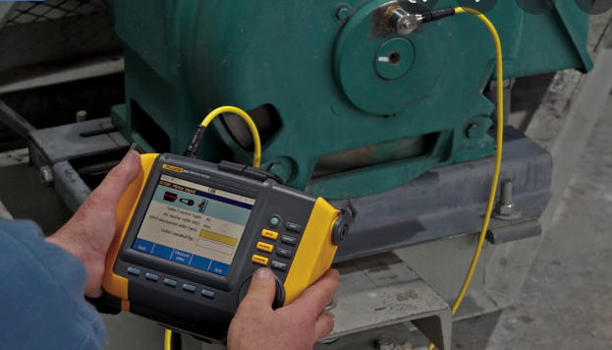
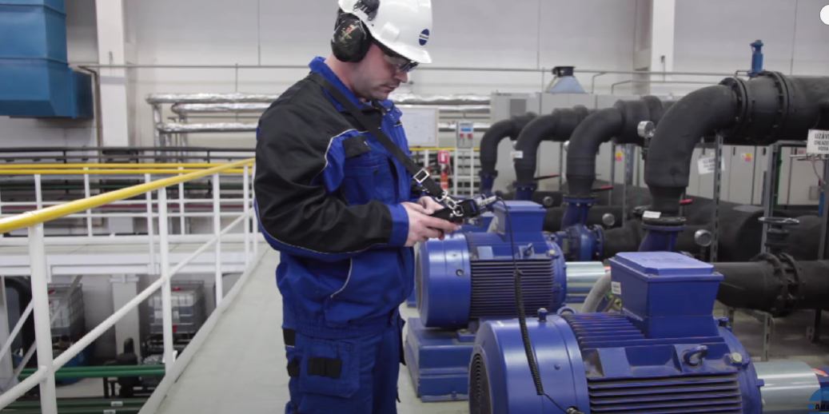
Existing Solutions:

Slide 6
Working Principle:
The LabView acquires data from the ADXL345 sensor via the Arduino using the I2C protocol and then displays the data on the labview front panel .
When the vibrations of the sensor crosses a user defined limit then the relays are turned OFF, A indicator LED is switched ON to indicate that a fault has occurred and the program is stopped.

Slide 7
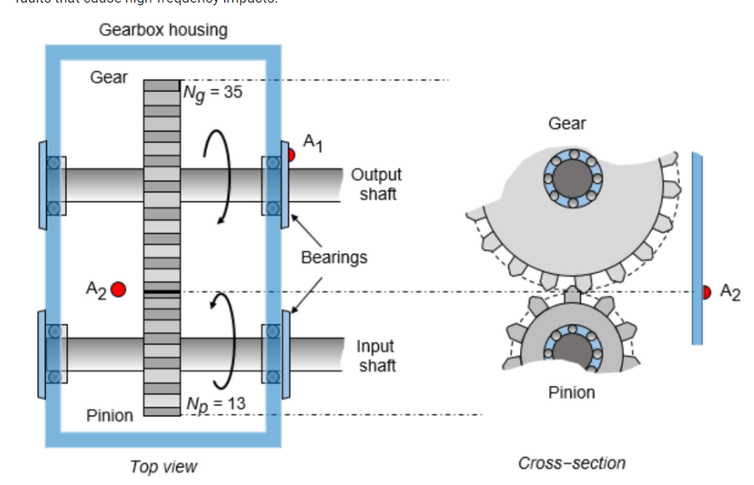
Vibration Analysis

Slide 8
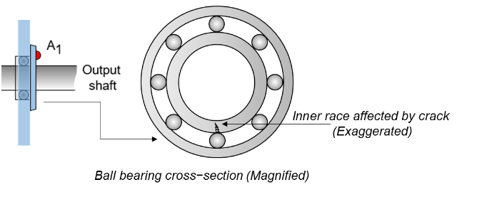
Vibration Analysis-Bearings

Slide 9
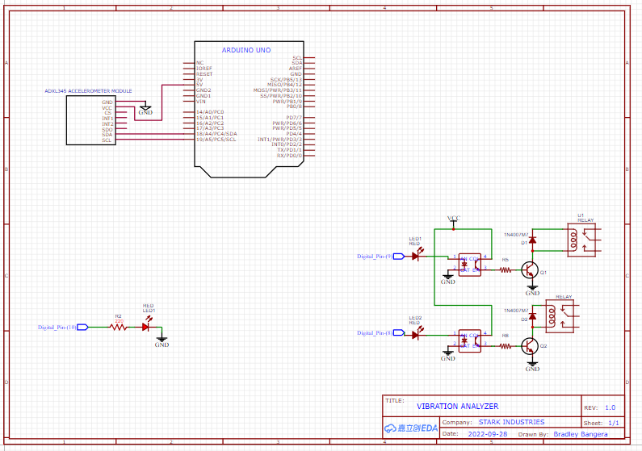
Circuit Diagram

Slide 10
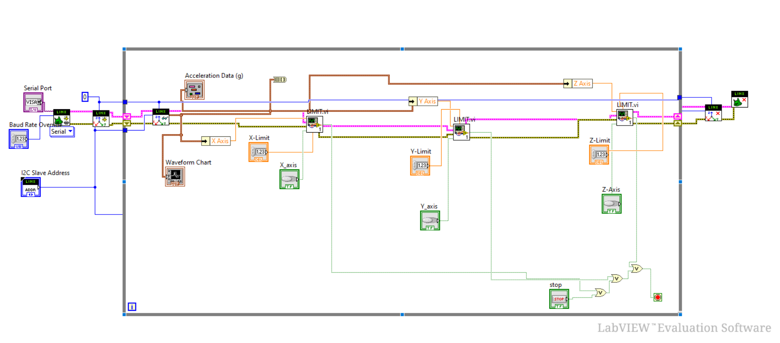
LabView VI

Slide 11
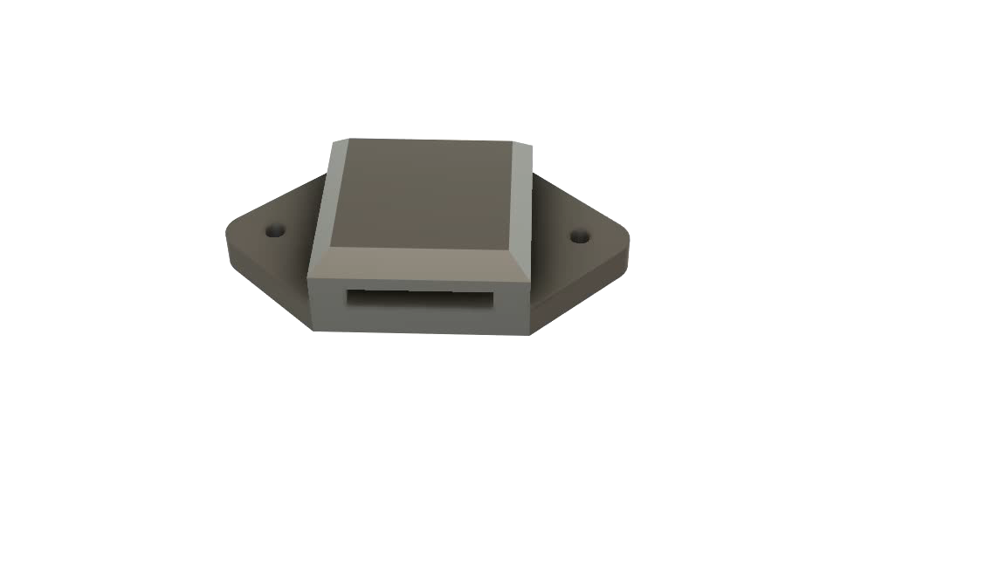
SENSOR MOUNT

Slide 12
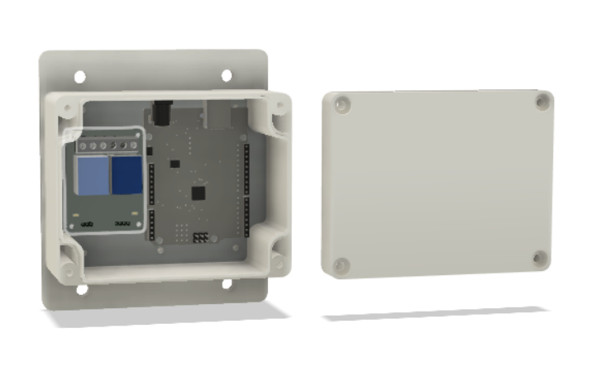
Enclosure

Slide 13
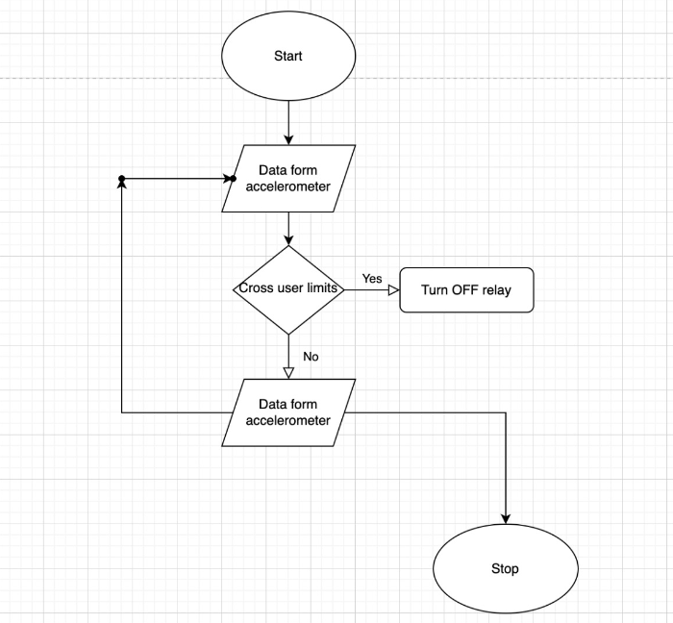
Flowchart

Slide 14
Results and Simulations
The vibrations caused by the source is sensed by the accelerometer and the data is acquired via the Arduino microcontroller and displayed via the waveform chart.
When the amplitude of the vibrations crosses the user set limits for either one of the axis then the relay is triggered (OFF) causing the device/Machine connected to it be isolated from the power supply
The user set limits can be set and activated by the appropriate buttons on the front panel of the VI
The program execution is stopped when a fault occurs (when the vibrations cross the user set limits)

Slide 15
Conclusion
The device has met the objective which was to analyze vibrations of a machine and shut off the fault to prevent further damage
The setup is capable of plotting and displaying all the data on the front panel as shown in the diagram

Slide 16
Limitations
1. Accelerometer Range: Our current accelerometer has a very low frequency detection range and thus cant be used for real life applications
2. Design of the Sensor Mount: we are looking into different methods of mounting the accelerometer onto the machine. The current solutions in the market use threaded metal studs or Permanent magnets to mount the sensor. The use of threaded studs ensures a proper fit of the sensor on the machine frame but requires a measuring point on the frame to do so, whereas the use of magnets allows us to place the sensor at any point of a metal frame of the machine.
Frequency analysis : the VI has to be programmed to calculate the frequency components of the virbrations

Slide 17
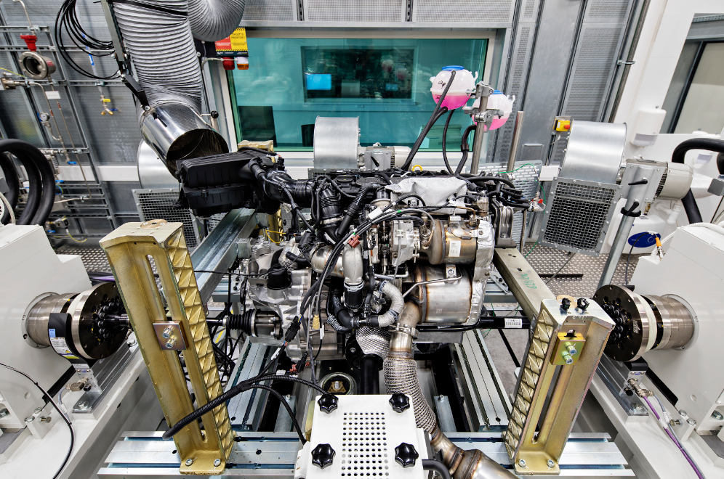
Applications:
Engine Test Benches

Slide 18
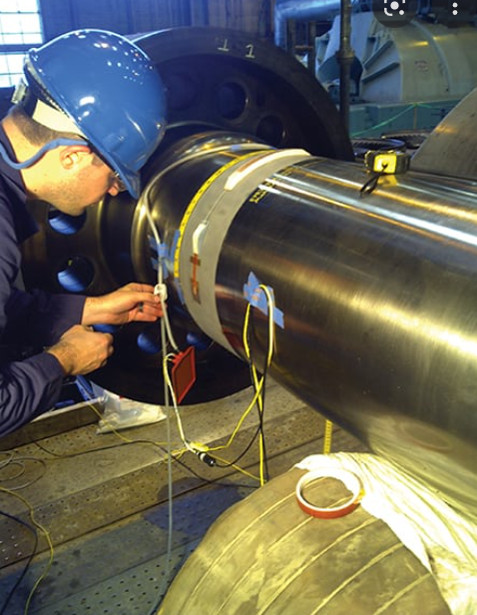
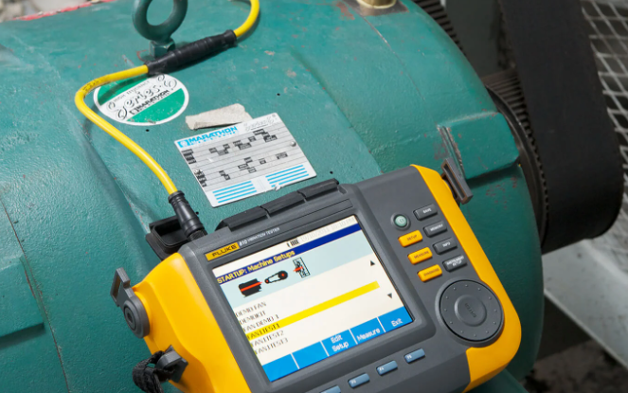
Applications:
Monitoring Generators and Motors for Faults

Slide 19
Impact on public safety
1. Machines produce vibrations under normal operation. These vibrations produced by machinery are vital indicators of machine health. Vibration analysis is used as a tool to determine a machine’s condition and the specific cause and location of problems, minimizing downtime and repair costs.
2. Untimely machinery breakdown due to faults such as imbalance, wear misalignment, etc causes significant losses, especially to the manufacturing company, as it can result in high monetary losses both from a potential motor or parts replacement, energy spikes within the system, and equipment downtime causing a halt in production.

Slide 20
Bill Of Materials
Sl No | Component list | Cost per unit (Rs) | Quantity | Total (Rs)
1 | Arduino Nano | 300 | 1 | 300
2 | ADXL345 Axis Accelerometer and (I2C) | 325 | 1 | 325
3 | Miscellaneous: Perf Board,Connectors, Enclosures,Screws, etc | - | - | 350

Slide 21
Thank You!!

